Slide 1


PGCDS ASSIGNMENT #2
Post Graduate Certification in Data Science (PGCDS)
Applied Econometrics – assignment #2
TIME SERIES ANALYSIS using ARIMA modeling
REDBUS website data analysis & prediction
Sonali A. Nimkar
Powered by:
February 2016
version 1.0

Slide 2

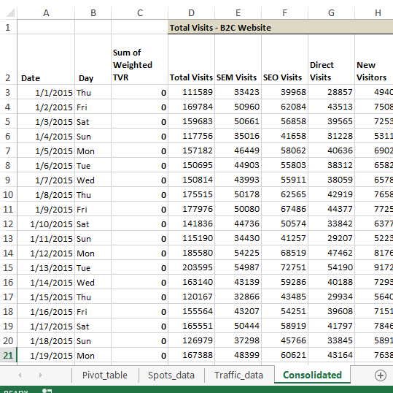
Background
The objective is to analyze time series data and prepare a forecast for the next n periods.
The data used: Redbus website visit data.
Training Set: Jan 01, 2013 – Dec 31, 2014 [730 data points]
Testing Set: Jan 01, 2015 – Apr 19, 2015 [109 data points]
Forecast made for test data [109], [30], [20] & [10] periods.

Slide 3
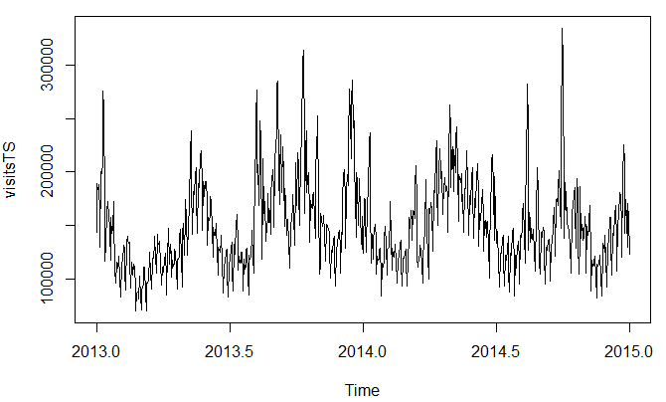
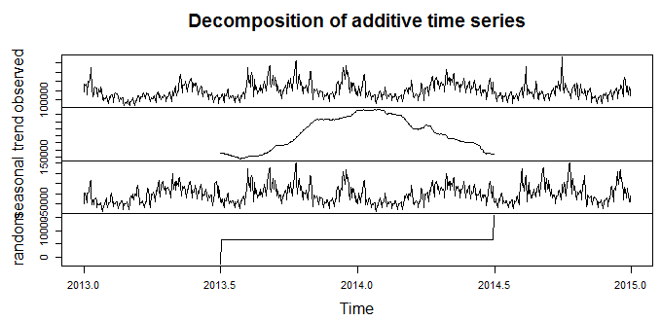
Original Series
Original series show seasonality and appear stationary.
Decomposition shows the seasonality however, there seems to be some problem with the trend and random components.

Slide 4
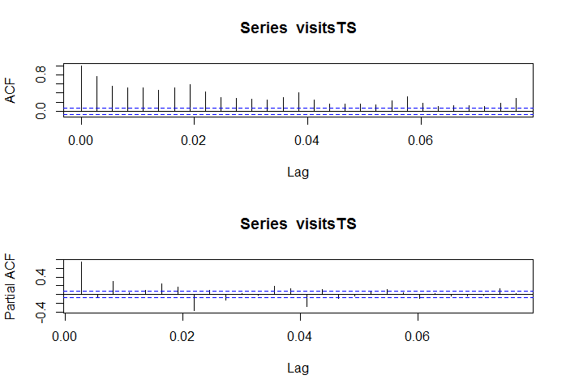
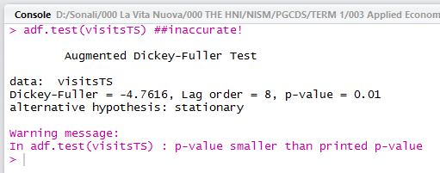
Original Series – not stationary!
As it turns out, the ACF plot fails to uphold stationarity.
The adf test, however, still claims stationarity.
We go with the ACF, and take the first difference of the series for further analysis.

Slide 5
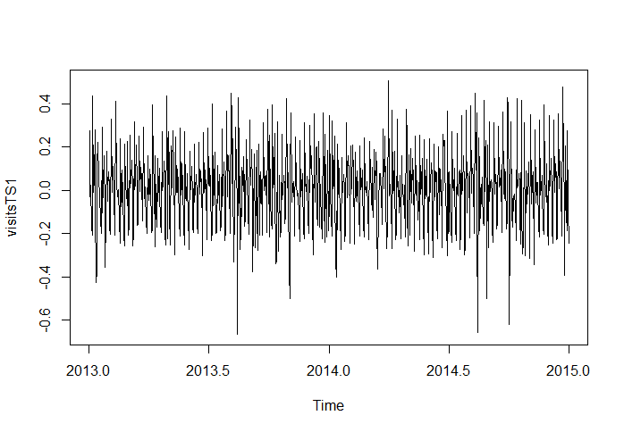
Differenced Once …
The series differenced once indicates stationarity.
This is tested, results shown on next slide.

Slide 6
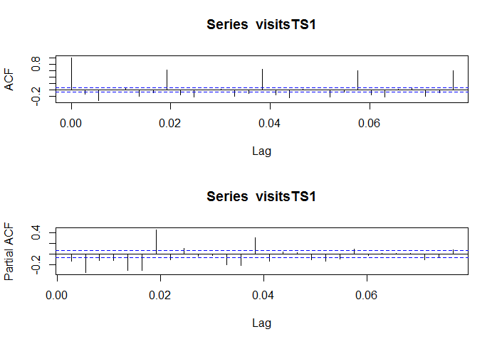
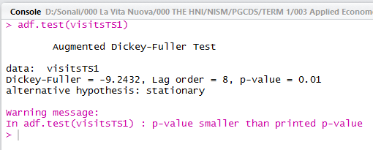
Differenced once - stationary
The differenced series is stationary and can be used for analysis.
We proceed with building an ARIMA model with this series.

Slide 7
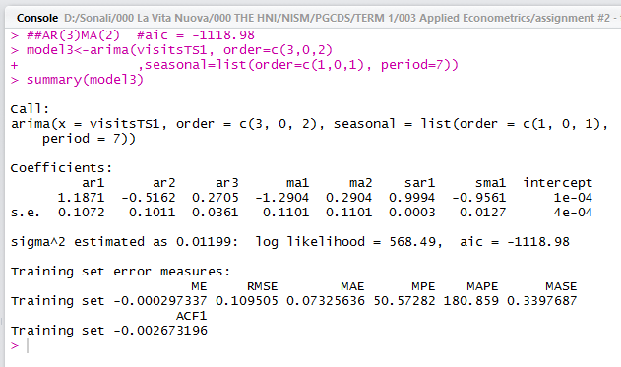
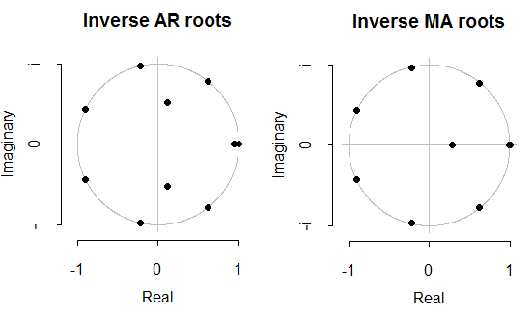
ARIMA model
AR(3) MA(2) [7] turns out to be the best model; with AIC = -1118.98.
AR(2) MA(2) [7] – AIC = -1100.26
AR(4) MA(2) [7] – AIC = -1116.10
AR(5) MA(2) [7] – AIC = -1107.59

Slide 8
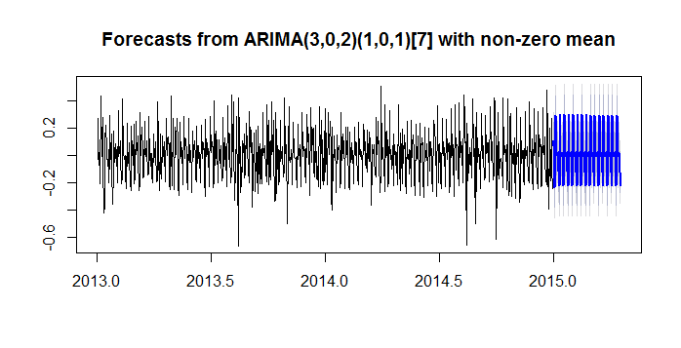
Forecast
Forecast generated for 109 periods (days) for Y2015
Model 3 used (from previous slide)

Slide 9
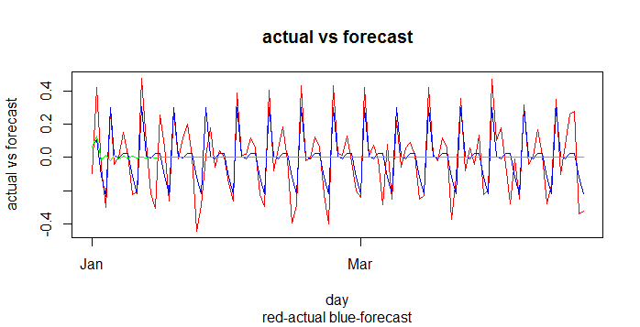
Actual vs Forecast
red – actual, blue – forecast (manual model), green – forecast (auto model)
Comparison between the differenced values (i.e. rates of change of visits)
RMSE = 0.128228 (for manual model), 0.218979 (auto model)

Slide 10
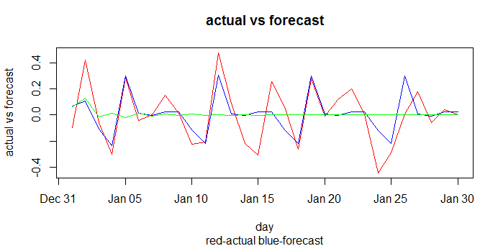
Actual vs Forecast (zoom in 30 periods)
red – actual, blue – forecast (manual model), green – forecast (auto model)
Comparison between the differenced values (i.e. rates of change of visits) – for 30 periods only
RMSE = 0.128228 (for manual model), 0.218979 (auto model)

Slide 11
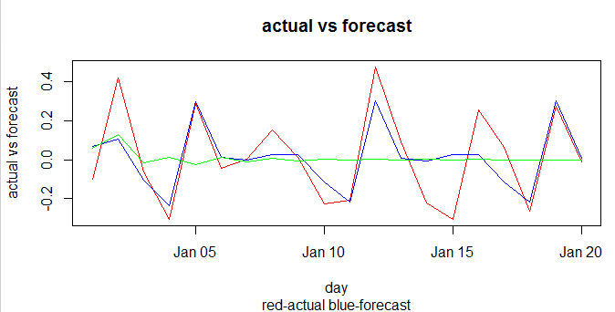
Actual vs Forecast (zoom in 20 periods)
red – actual, blue – forecast (manual model), green – forecast (auto model)
Comparison between the differenced values (i.e. rates of change of visits) – for 20 periods only
RMSE = 0.128228 (for manual model), 0.218979 (auto model)

Slide 12
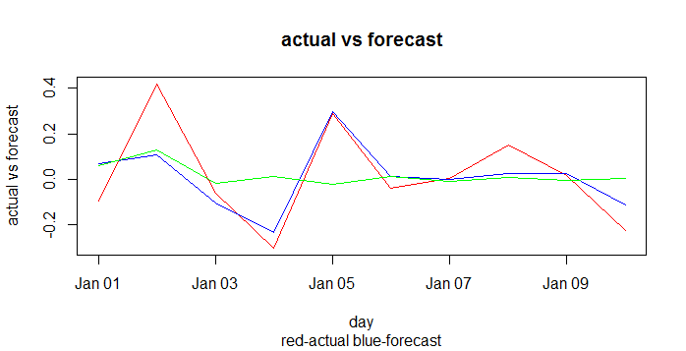
Actual vs Forecast (zoom in 10 periods)
red – actual, blue – forecast (manual model), green – forecast (auto model)
Comparison between the differenced values (i.e. rates of change of visits) – for 10 periods only
RMSE = 0.128228 (for manual model), 0.218979 (auto model)

Slide 13
Thank you!

